Slide 1
A NEW CHURCH APP
Introducing iWorship
One app for your church — to sing together, hear the Word, and grow in faith all week long.
First presentation
Notes:
Welcome everyone. Today I want to show you iWorship — an app we built for our church. In one sentence: it helps us sing together on Sunday and stay connected the rest of the week.

Slide 2
WHAT IS IWORSHIP?
Songs, Sunday service, and church family — in one app
iWorship helps a church do three things: sing together, run the Sunday service, and stay connected during the week. It works on a phone, a tablet, or the church laptop.
Made for the Philippines
English and Tagalog Bible, built in.
Free to start
Sign in and use it right away.
Works on any device
Phone, tablet, or the church laptop.
IWORSHIP
Notes:
Most churches use several tools: a songbook, PowerPoint for the projector, and group chats for announcements. iWorship puts all of that in one place. It already includes the King James Bible and the Tagalog Ang Dating Biblia, and it is free to start.

Slide 3
READY TODAY
What’s Already Built
Everything in this part works today.
Notes:
Let me show you what is already working. Everything in this next section is live in the app right now — these are real screens.

Slide 4
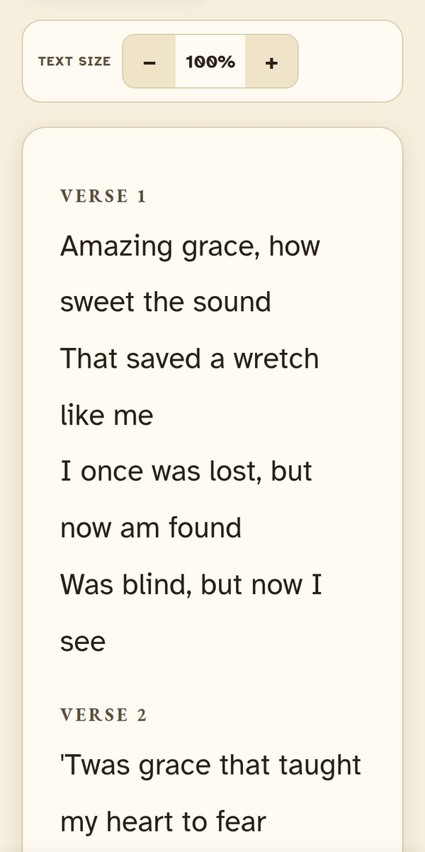
FEATURE
The Hymnal
Big, easy-to-read lyrics for everyone — and chords for the musicians, in any key.
Search by title, number, or theme
Change the key with one tap
Save your favorite songs
Add a song by pasting the lyrics
IWORSHIP
Notes:
This is the hymnal. Lyrics are big enough for our elders to read. Musicians can switch to Play Mode to see chords and change the key with one tap. Every church on iWorship shares the same growing song library.

Slide 5
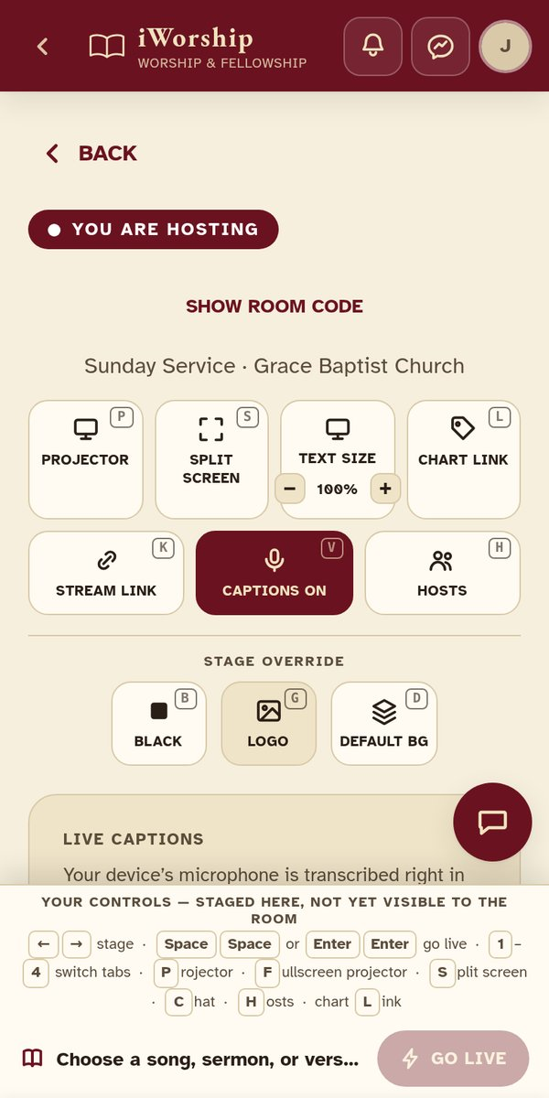
FEATURE
Run a Worship Service
Show songs, Bible verses, and sermon slides on the big screen — and on everyone’s phone at the same time.
People join by scanning a QR code
A projector view for the big screen
Upload your PowerPoint slides
Live captions, with translation
IWORSHIP
Notes:
This is the host screen. One person controls the service from a phone or laptop. Whatever they choose shows on the projector and on everyone’s phone. People join by scanning a QR code — no typing needed.

Slide 6
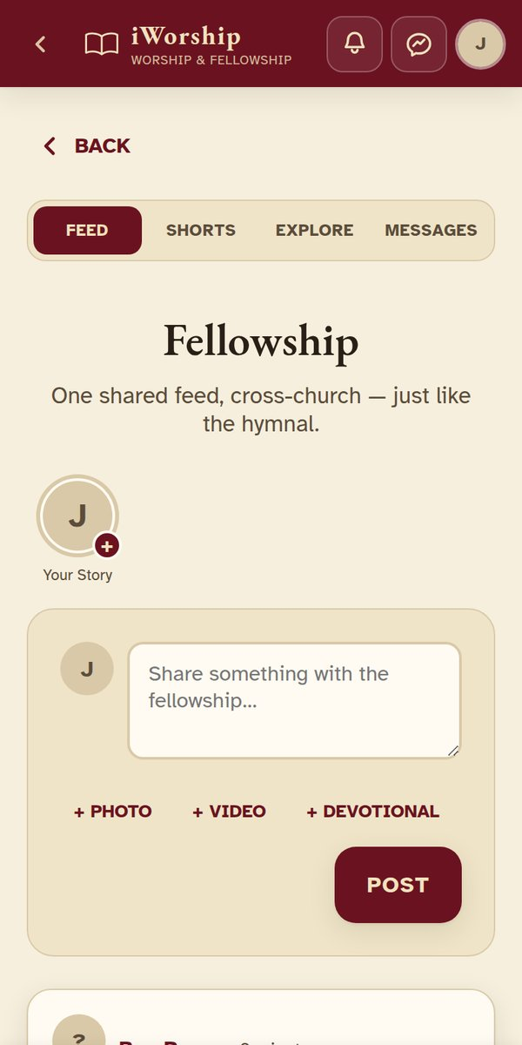
FEATURE
Fellowship
A social feed just for your church family — to share news and stay close between Sundays.
Share posts, photos, and videos
Send messages and group chats
Follow people in your church
IWORSHIP
Notes:
Church does not end when the service ends. Fellowship is like a small Facebook just for church members. You can post updates, share photos, and message each other.

Slide 7
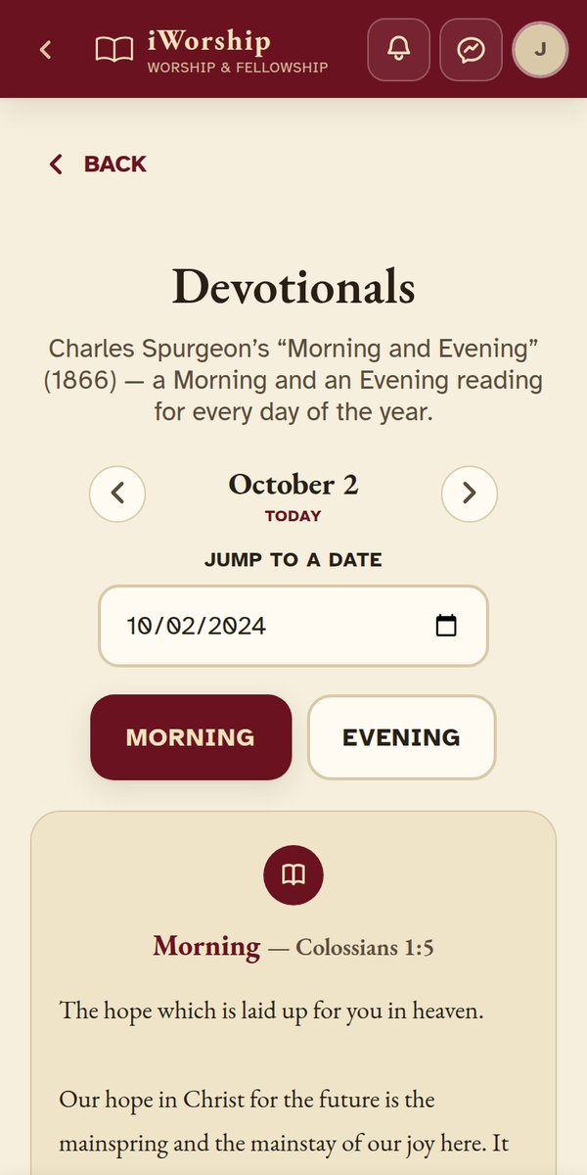
FEATURE
Daily Devotionals
A short reading every morning and evening, from Charles Spurgeon’s Morning and Evening.
A new reading every day
Go to any day of the year
Share a reading with the church
IWORSHIP
Notes:
Every day there is a new morning and evening devotional, free for everyone. It uses Charles Spurgeon’s classic Morning and Evening, which is public domain.

Slide 8
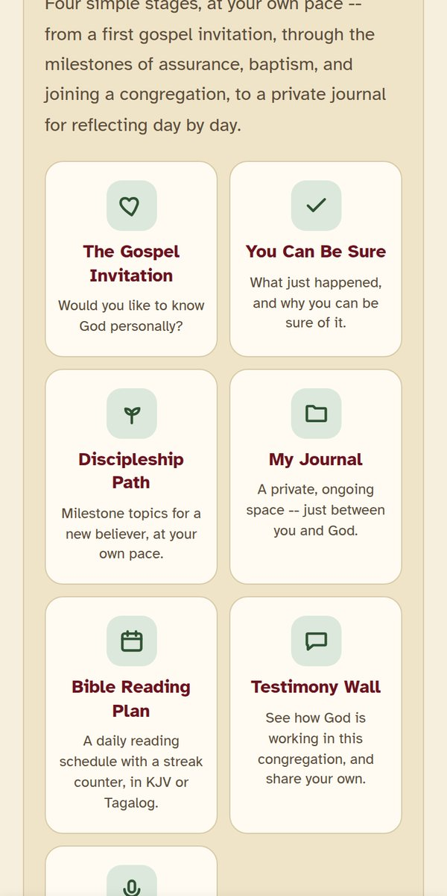
FEATURE
Spiritual Growth
A simple guide for anyone who is new to the faith.
The gospel, explained simply
Step-by-step lessons for new believers
A private journal only you can read
IWORSHIP
Notes:
This is for new believers or anyone curious about faith. It starts with the gospel, then walks them through simple lessons — assurance, baptism, joining a church. The journal is completely private; not even the pastor can read it.

Slide 9
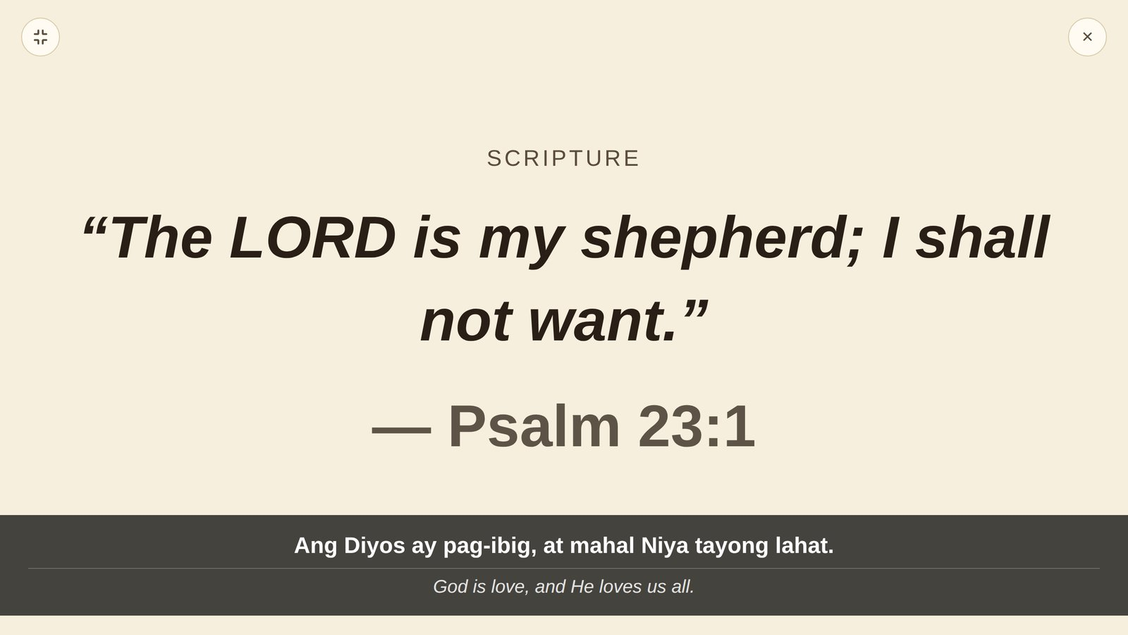
NEW · SERMONS & TEACHING
Live Captions & Translation
As the pastor speaks, the words appear on the screen. Turn on translation to show Tagalog and English together.
Everyone can follow — in their own language.
IWORSHIP
Notes:
This is one of the newest features. When the pastor preaches, the app listens and shows the words on the projector. You can also turn on translation — here, Tagalog is shown on top and the English translation below. It helps members who are hard of hearing, and visitors who speak another language.

Slide 10
NEW · SERMONS & TEACHING
Sermon Archive
Pastors can post past sermons. Anyone can read them later, slide by slide — even without an account.
A sermon doesn’t end when Sunday does.
IWORSHIP
Notes:
If someone missed a Sunday, they can catch up here. The pastor chooses which sermons to post.

Slide 11
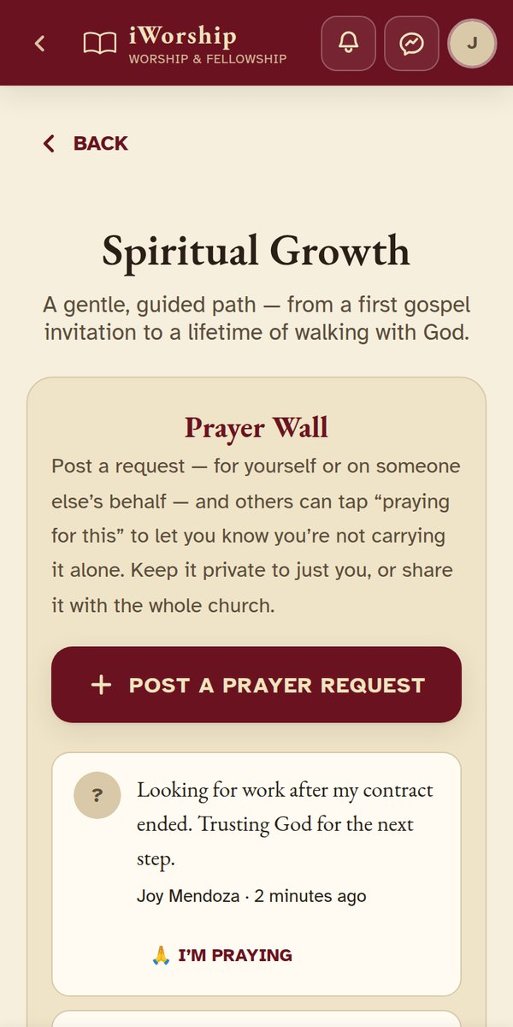
NEW · PRAYER & SPIRITUAL LIFE
Prayer Wall
Post a prayer request. Others tap “I’m praying” so you know they’re with you. Mark it answered when God answers.
Nobody prays alone.
IWORSHIP
Notes:
Members can post a prayer request — private, or shared with the church. Others tap “I’m praying.” When the prayer is answered, you can mark it answered. The latest requests also show on the home screen. (The names on this screen are sample data.)

Slide 12
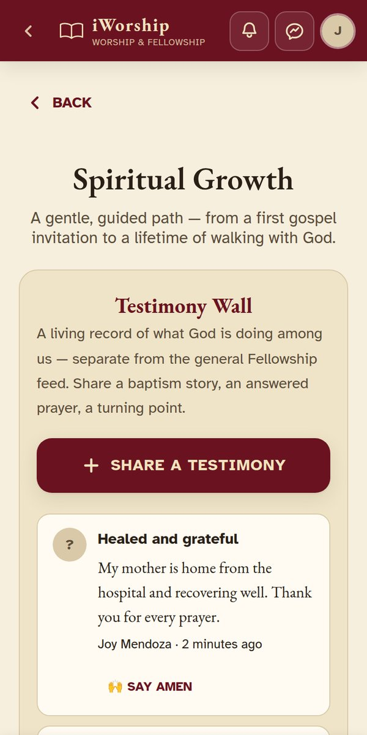
NEW · PRAYER & SPIRITUAL LIFE
Testimony Wall
Share what God has done in your life. Others can say “Amen” to celebrate with you.
One story can encourage many.
IWORSHIP
Notes:
This is where members share answered prayers and good news. The most-loved stories are featured on the home screen.

Slide 13
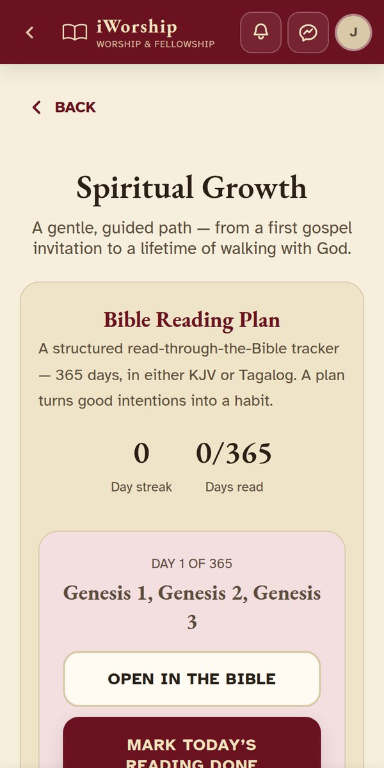
NEW · PRAYER & SPIRITUAL LIFE
Bible Reading Plan
Read the whole Bible in one year — in English or Tagalog. Fall behind? Just continue where you stopped.
A little each day adds up.
IWORSHIP
Notes:
The plan gives you a few chapters each day. Tap done, and your streak grows. If you miss a day, nothing is lost — you just continue from where you stopped.

Slide 14
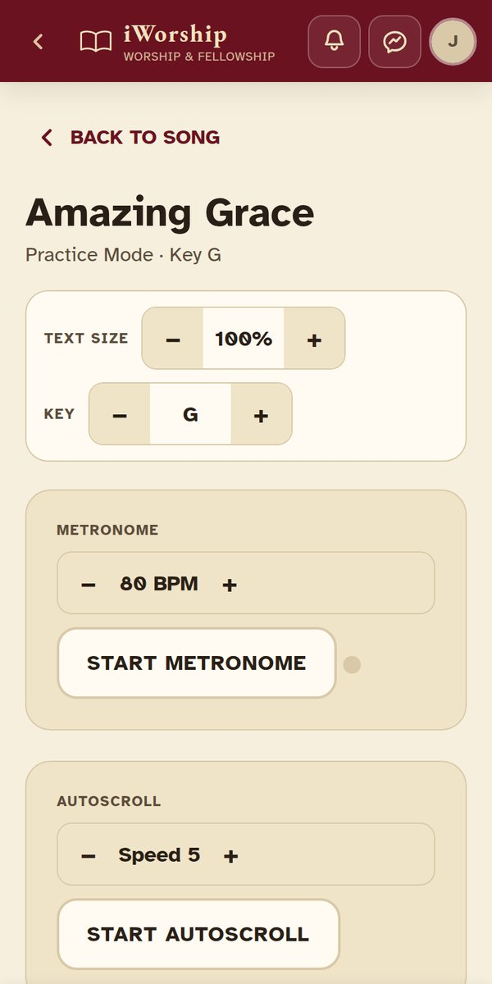
NEW · WORSHIP & MUSIC
Practice Mode
Musicians can practice with chords, a metronome, and lyrics that scroll by themselves.
A ready team leads with confidence.
IWORSHIP
Notes:
For our musicians: open any song, tap Practice Mode, set the tempo, and play along. The lyrics scroll by themselves so you never have to touch the screen.

Slide 15
NEW · WORSHIP & MUSIC
Worship Team Schedule
Leaders assign who serves each Sunday. Each person confirms or declines right in the app.
No more chasing replies in group chats.
IWORSHIP
Notes:
The worship leader picks who plays or sings on each date. Each person sees their own schedule and confirms with one tap.

Slide 16
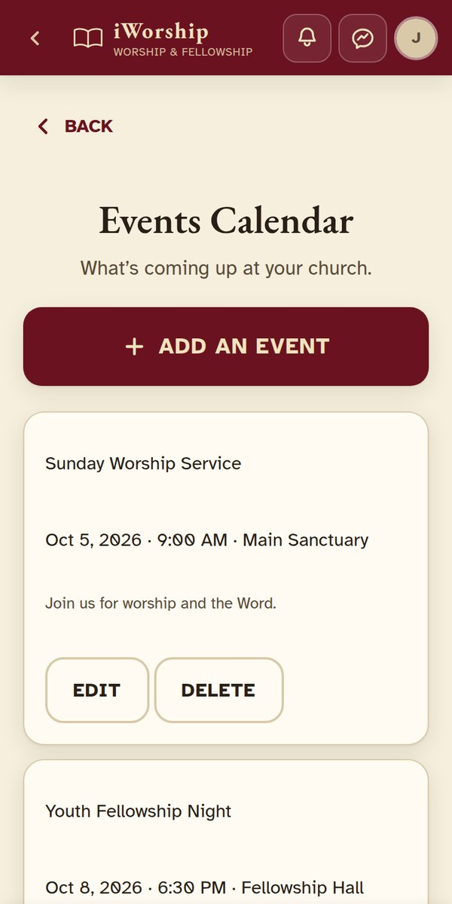
NEW · CHURCH LIFE
Events Calendar
See what’s coming up at church — services, fellowships, and outreach.
Never miss what matters.
IWORSHIP
Notes:
Leaders post upcoming events here, with the date, time, and place. Everyone can see what is coming up. (These events are sample data.)

Slide 17
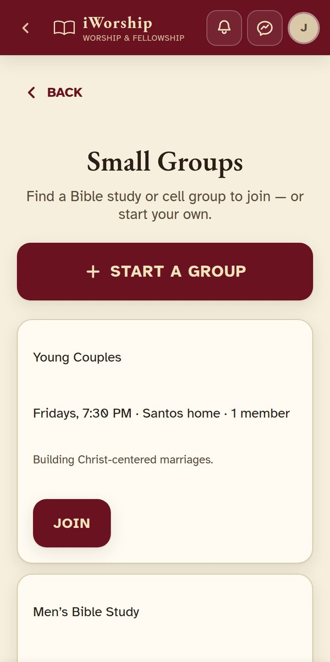
NEW · CHURCH LIFE
Small Groups
Find a Bible study or small group. Join with one tap — or start your own.
Real growth happens in small circles.
IWORSHIP
Notes:
Members can browse Bible studies and small groups, see when and where they meet, and join with one tap.

Slide 18
NEW · CHURCH LIFE
Church Directory
See everyone in your church in one list.
Know your church family by name.
IWORSHIP
Notes:
A simple list of everyone in our church, so you can put a name to a face and reach out to new members.

Slide 19
LOOKING AHEAD
Where We’re Headed
Ideas for the future. None of these are built yet.
Notes:
Now, a few ideas for what could come next. These are not built yet — I would love your thoughts on them.

Slide 20
IDEA · WORSHIP & MUSIC
Suggest a Song
Members suggest songs from the hymnal for Sunday. The worship leader still makes the final choice.
Everyone gets a voice.
IWORSHIP
Notes:
Members could vote for songs they want to sing. The worship leader would still decide the final list.

Slide 21
IDEA · REACHING MORE PEOPLE
Full App Translation
The whole app — every menu and button — in Tagalog, and later Cebuano, Ilocano, and more.
Faith shouldn’t need a second language.
IWORSHIP
Notes:
Today, Tagalog is in the Bible and in live translation. This idea would translate the whole app, so every member can use it in their own language.

Slide 22
IDEA · REACHING MORE PEOPLE
Kids Ministry Mode
A simpler view for children’s church: big buttons and kid-friendly songs.
Faith starts young.
IWORSHIP
Notes:
A lighter version of the app for Sunday school and children’s church, so kids can follow along too.

Slide 23
LET’S BEGIN
This Is Only the Beginning
Everything you saw today is ready to use. Thank you for taking this first step with iWorship!
iWorship — songs, service, and church family, in one app
Notes:
Thank you. Everything I showed you in the first part is ready to use today. I am happy to help anyone get started, and I would love to hear which future ideas matter most to you.

